Slide 1
SR A1A / SR 200 Reconstruction Project
Public Information Meeting

Slide 2
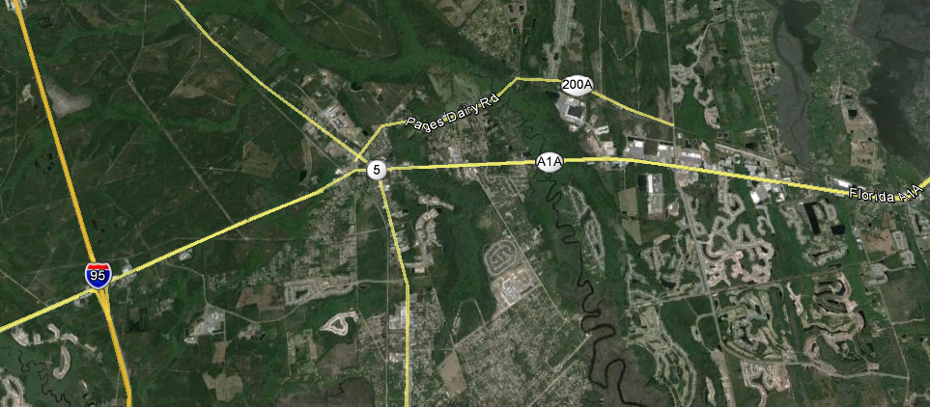
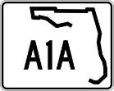
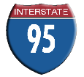
PROJECT LIMITS
I-95 to West of Still Quarters Rd.
FM # 210711-2
West of Rubin Davis Lane to East of CR-107/O’Neil-Scott Rd.
FM #210712-4
West of Still Quarters Rd to West of Rubin Davis Lane
FM # 210712-3

Slide 3
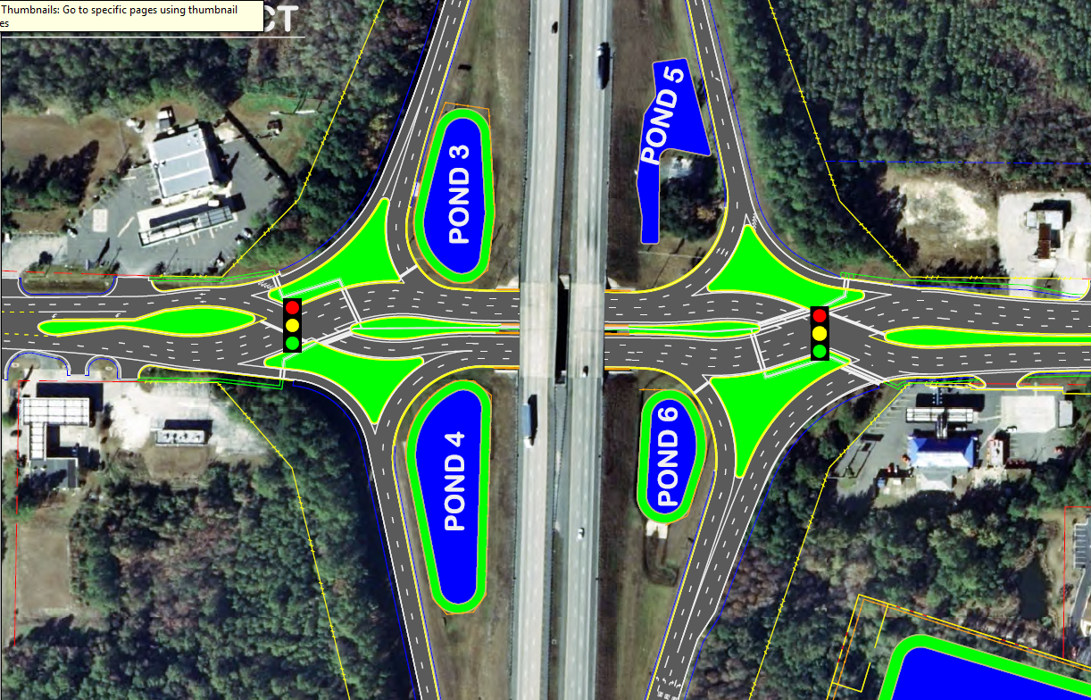
Diverging Diamond Interchange

Slide 4
What is a Diverging Diamond Interchange?
The diverging diamond interchange, known as a DDI, is designed to allow two directions of traffic to temporarily cross to the opposite side of the roadway to provide easier access on and off the freeway.
FEATURES
Limits number of traffic signal phases required to move motorists through the interchange
Movements on and off the freeway have fewer conflict points and can be free-flowing
Moves high volumes of traffic without increasing the number of lanes in an interchange.

Slide 5
What are the Benefits?
Safety
Fewer conflict points (14 for DDI, 26 for conventional)
Better sight distance at turns
Wrong way entry to ramps extremely difficult
Operations
Simple left and right turns from all directions
Increases left turn lane capacity without adding lanes
Two phase signals with shorter cycle lengths reduces delay
Better storage between the ramp terminals

Slide 6
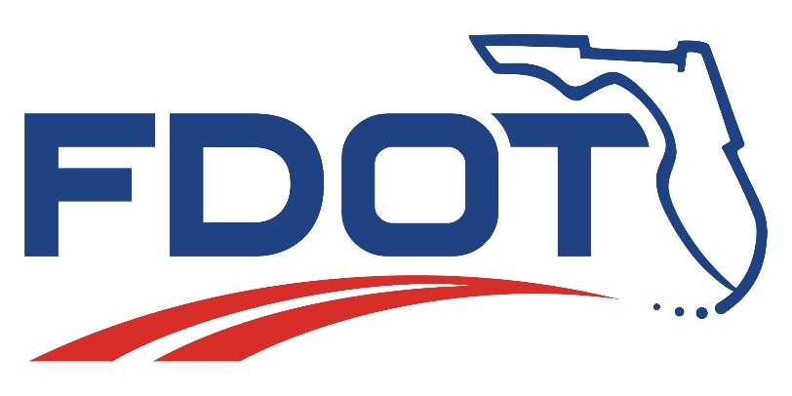
Thank you for coming!

